Slide 1
Diversity gradients (computer lab)

Slide 2

During this session you will…
become familiar with basic theories explaining the latitudinal diversity gradient
develop scenarios of how changes in the "components" of biodiversity can result into observed diversity gradients
quantify latitudinal diversity gradients using the measurement of biodiversity framework
compare diversity patterns between different groups of organism (trees and reef fish)

Slide 3
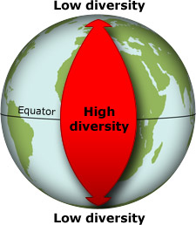
Introduction
Many taxa show latitudinal diversity gradients (LDG)
Strength and slope of relationship are variable
spatial scale, body mass, habitat type, global diversity, etc
Mechanisms shaping species pools:
time, speciation rate, extinction rate, dispersal, climatic stability, niche conservatism, …
Gradients in total community abundance (energy gradients)
more individuals hypothesis

Slide 4
How do rarefaction curves and the components of biodiversity change along the LDG?

Slide 5
Scenarios 1:

Slide 6
Scenarios 1:
Species richness
Number of individuals

Slide 7
Scenarios 1:
 | Equator | Poles
S
N
S_{n}
S_{PIE}
Species richness
Number of individuals

Slide 8
Scenarios 2:
 | Equator | Poles
S
N
S_{n}
S_{PIE}
Species richness
Number of individuals

Slide 9
Scenarios 3:
 | Equator | Poles
S
N
S_{n}
S_{PIE}
Species richness
Number of individuals

Slide 10
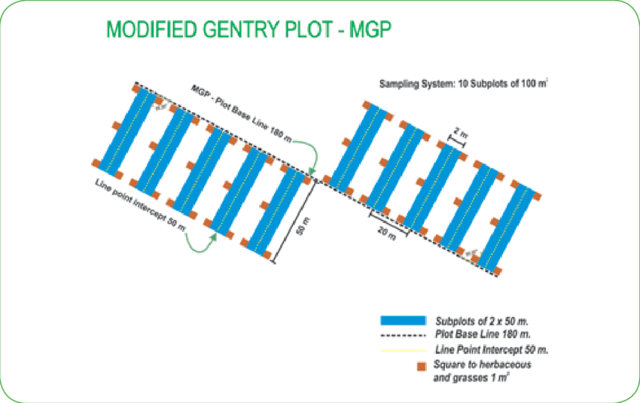
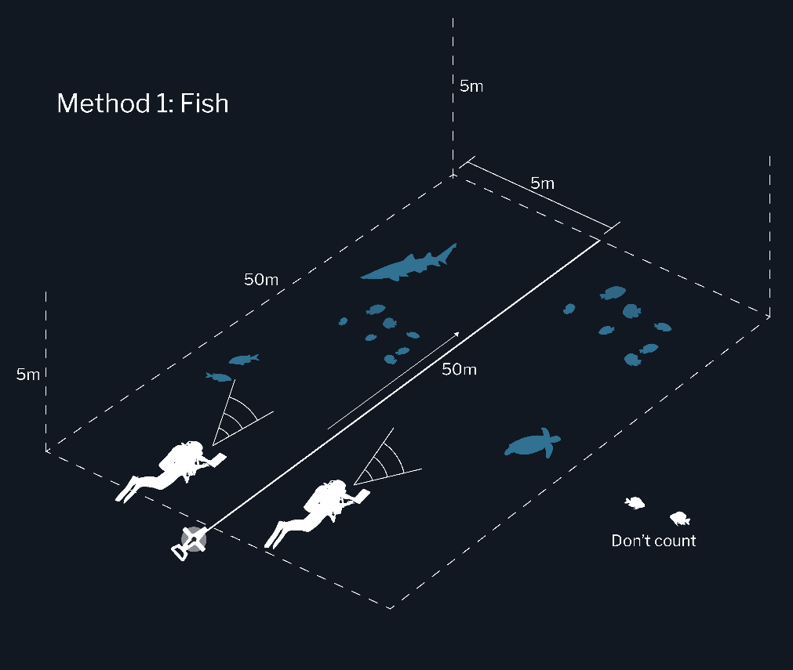
Datasets
Trees (Gentry forest plots)
Fish (Reef life survey)

Slide 11
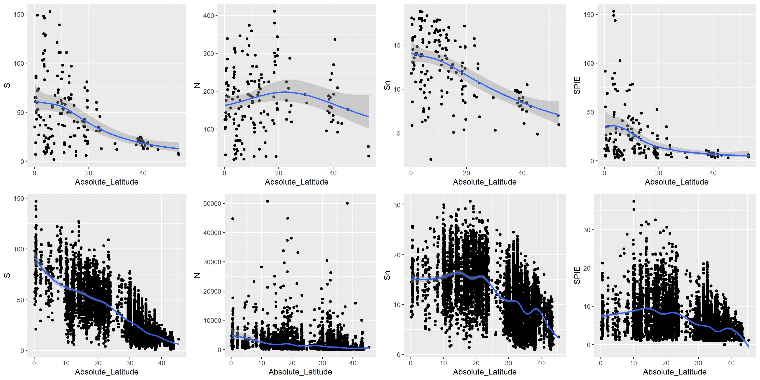
Trees
Fish

